Slide 1
COVID-Crisis
Teaching Learning Model adapted
Blended Learning
A Technology Enabled Learning Environment

Slide 2
KLE Tech. Blended Learning Model adopted during COVID-19
Video Lectures using light-board
Effective use of multimedia tools
Embedded tests for self assessment
Asynchronous Mode
Online
Post Test
Post test serves as feedback for teachers for synchronous session
Questions covering all content of asynch session
Questions at understanding level (Blooms)
Feed back on student learning
Feedback on post test
Summarization
Doubt clarifications
Complex problem solving excercises
Setting expectations
Online
Synchronous Mode
Traditional Classroom

Slide 3
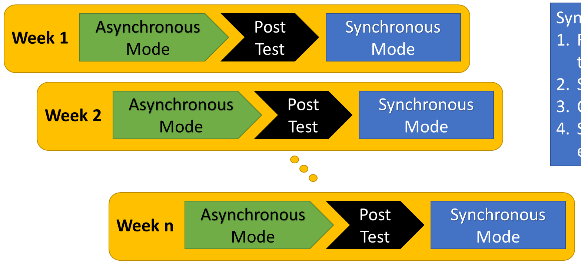
KLE Tech Blended Learning Model
Video
c
K L E Technological University, Hubli
2021

Slide 4
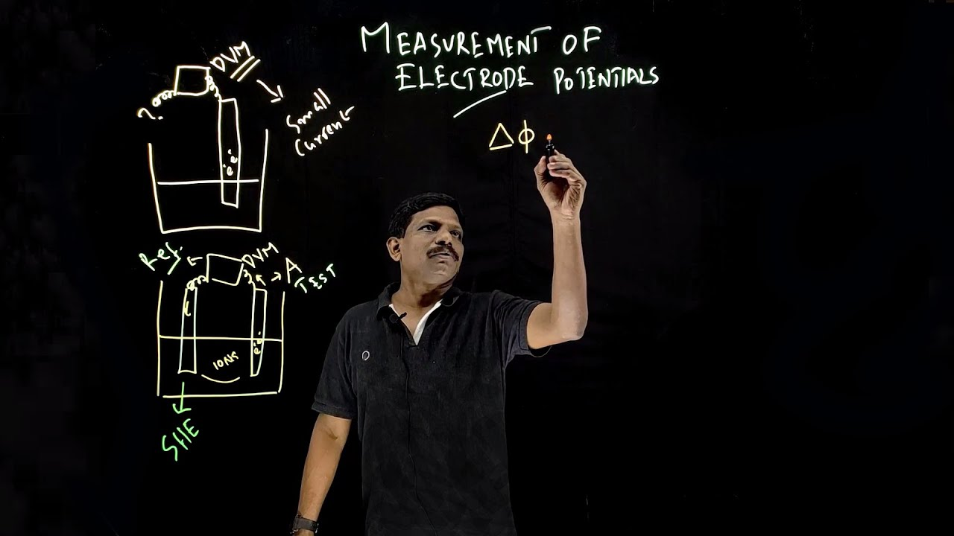
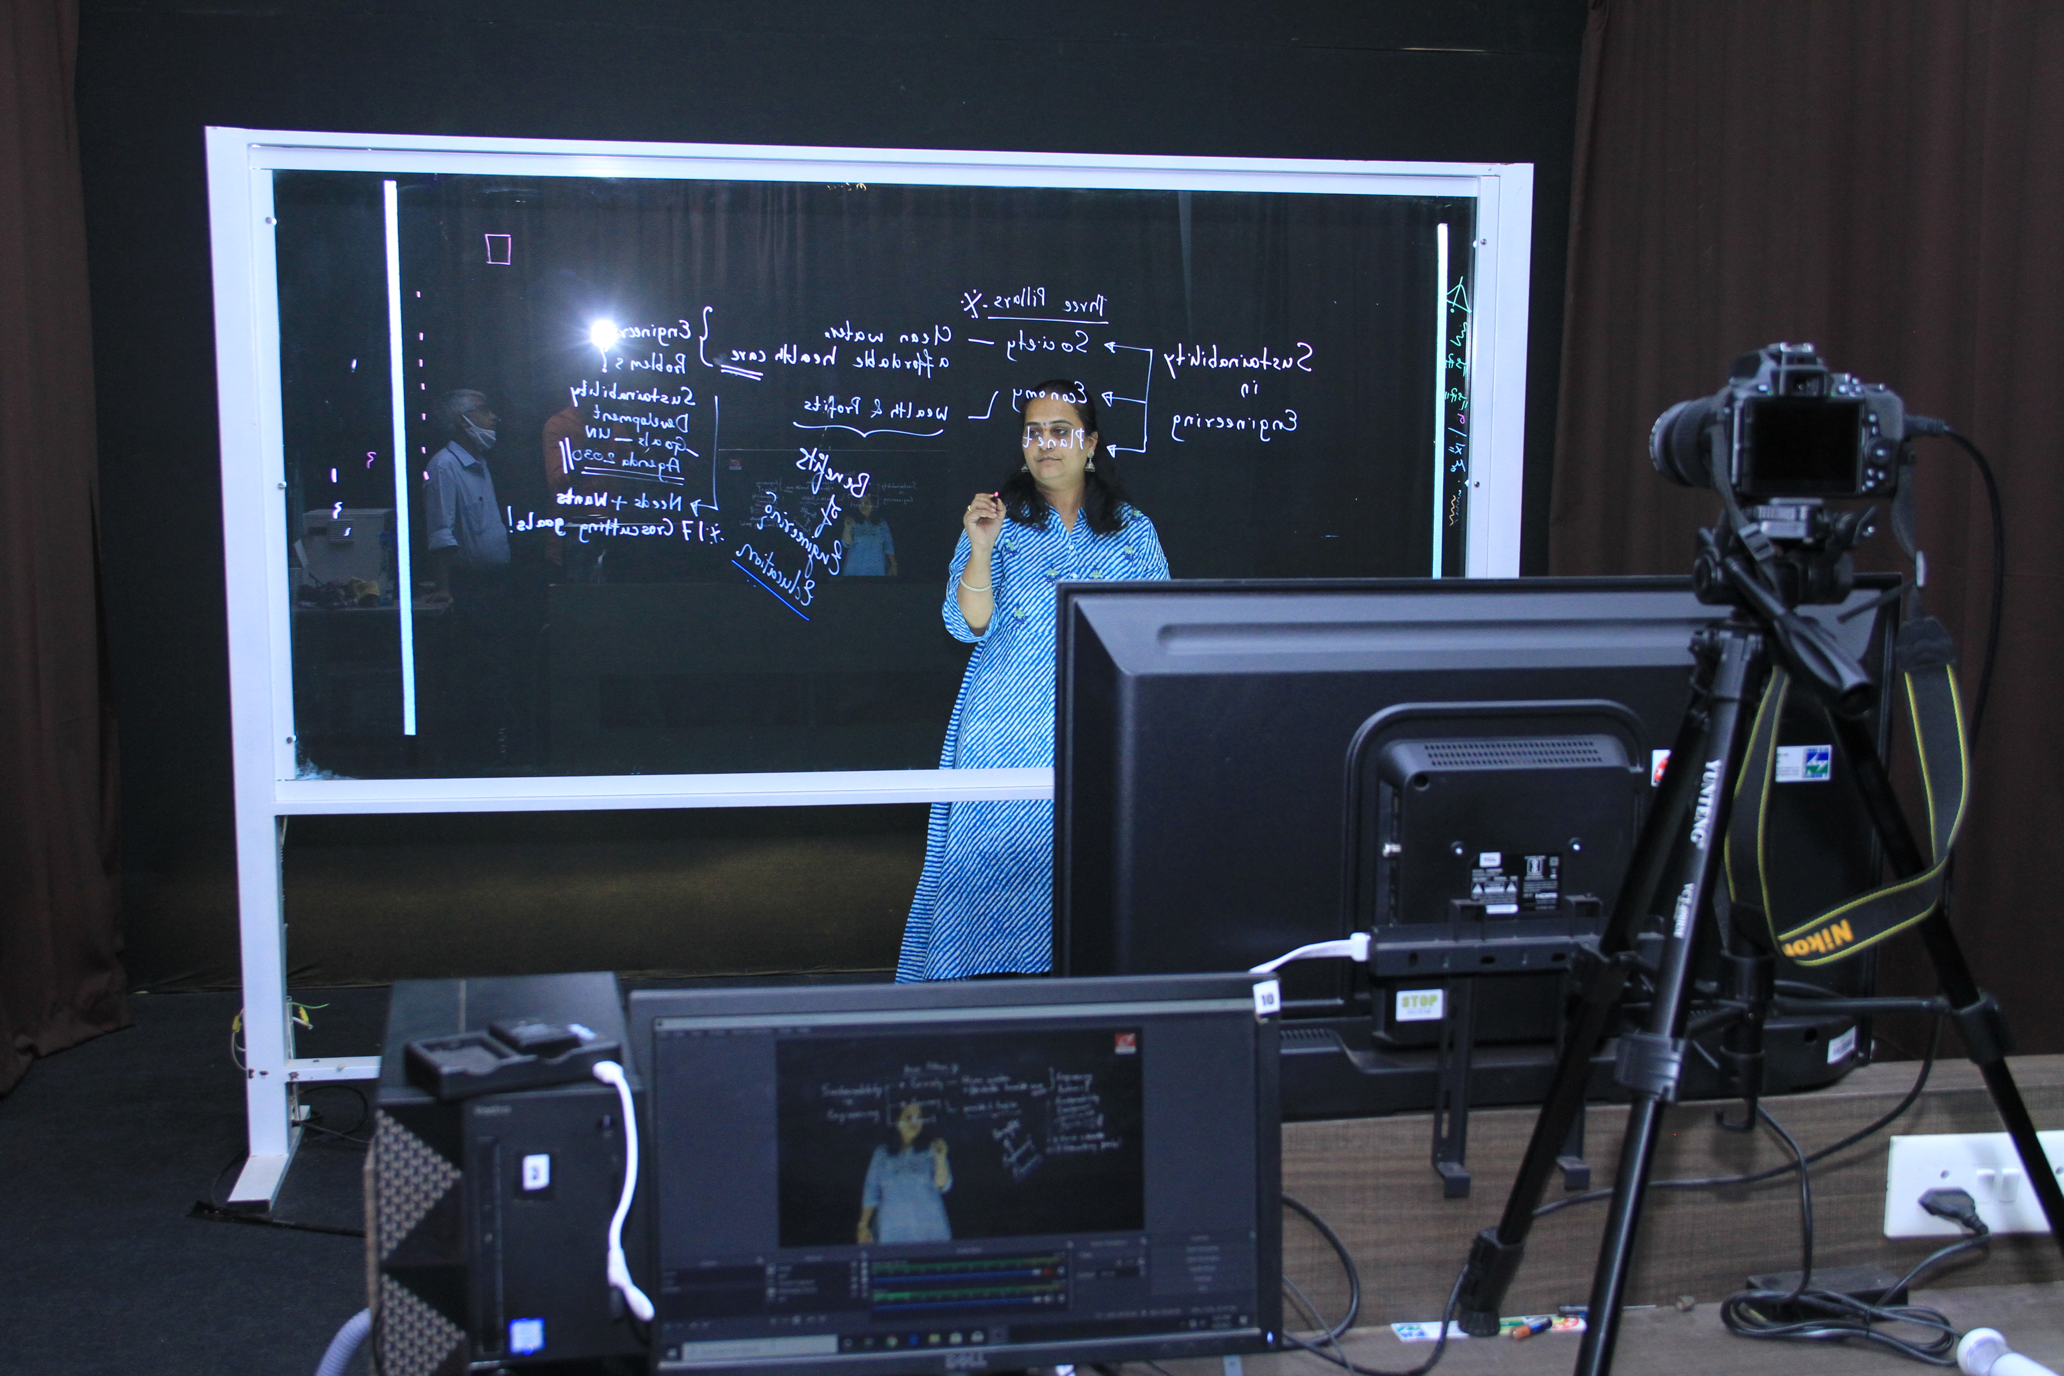
KLE Tech. Blended Learning Model adopted during COVID-19
Lightboard Video production setups
14 studios across campus
The Lightboard is a set of lecture recording tools that allow production of high-quality videos where the presenter both faces the students and writes on a glass board as they would in a regular class.
Engages learners better by providing greater visual connection with the lecturer.
Graphics, visual simulations can be integrated into lectures
Video

Slide 5
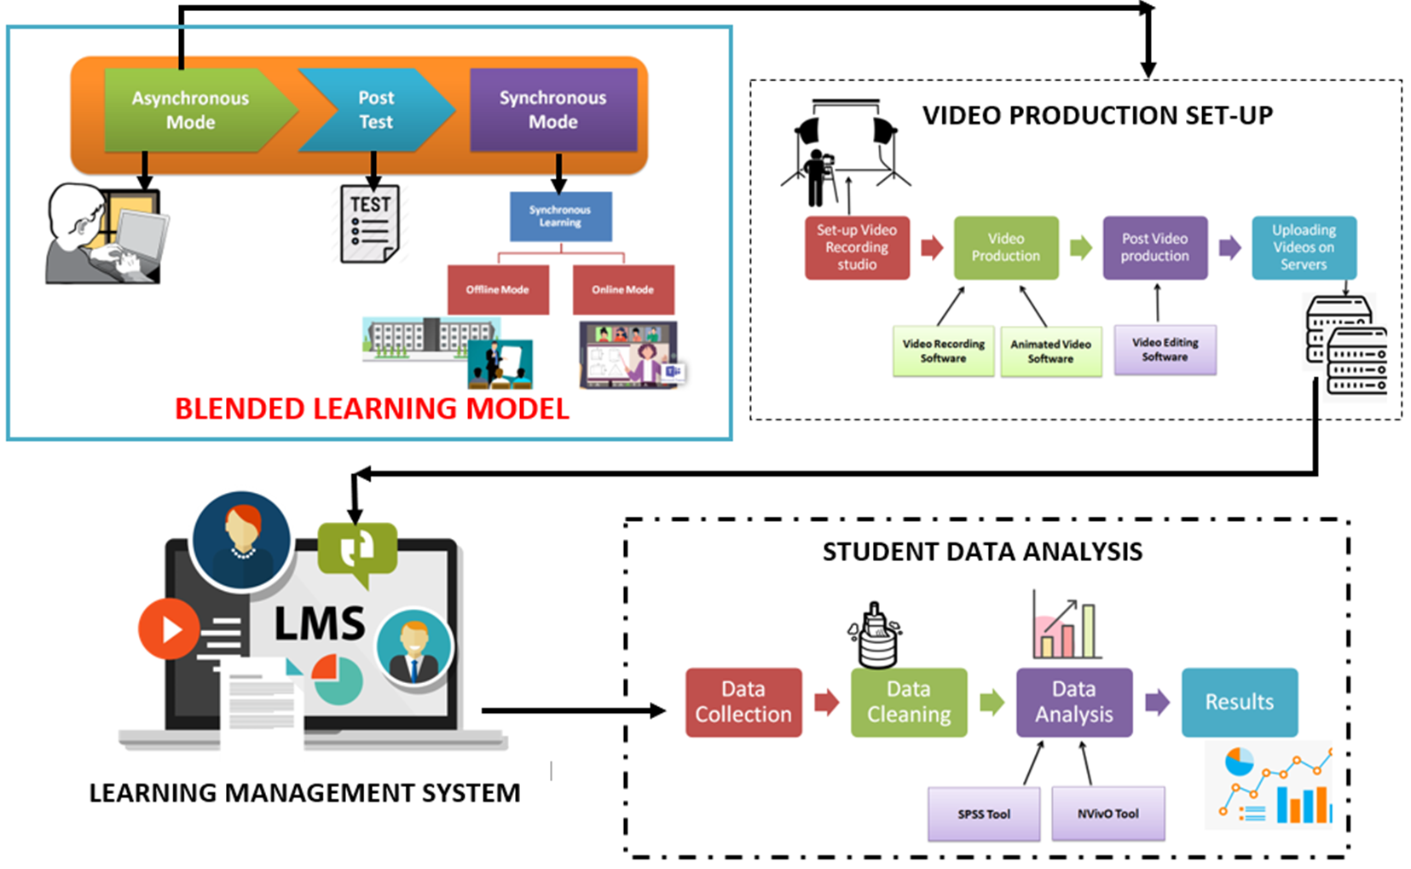
KLE Tech Blended Learning Model
VIDEO PRODUCTION SETUP
BLENDED LEARNING MODEL
STUDENT DATA ANALYTICS
LEARNING MANAGEMENT SYSTEM

