Slide 1

Examination Process

Slide 2

Examination Process
Examination Section
Appointing Faculty’s for Various Activities
Preparation for Exams
  Panel of Examiners
  Question Paper
  Time-Table
  Seating Arrangements
Conduction of Exams
Evaluation
Review of Results from Result Scrutiny Committee
Course Registration List from Each Program
In-eligible List
I Grade list
Withdrawal List
Announcement of Results and Issuing Essential Certificates
Re-Evaluation

Slide 3
Examination Process
Examination Section
Course Registration
ISA Evaluation
QP process
Evaluation process
Results

Slide 4
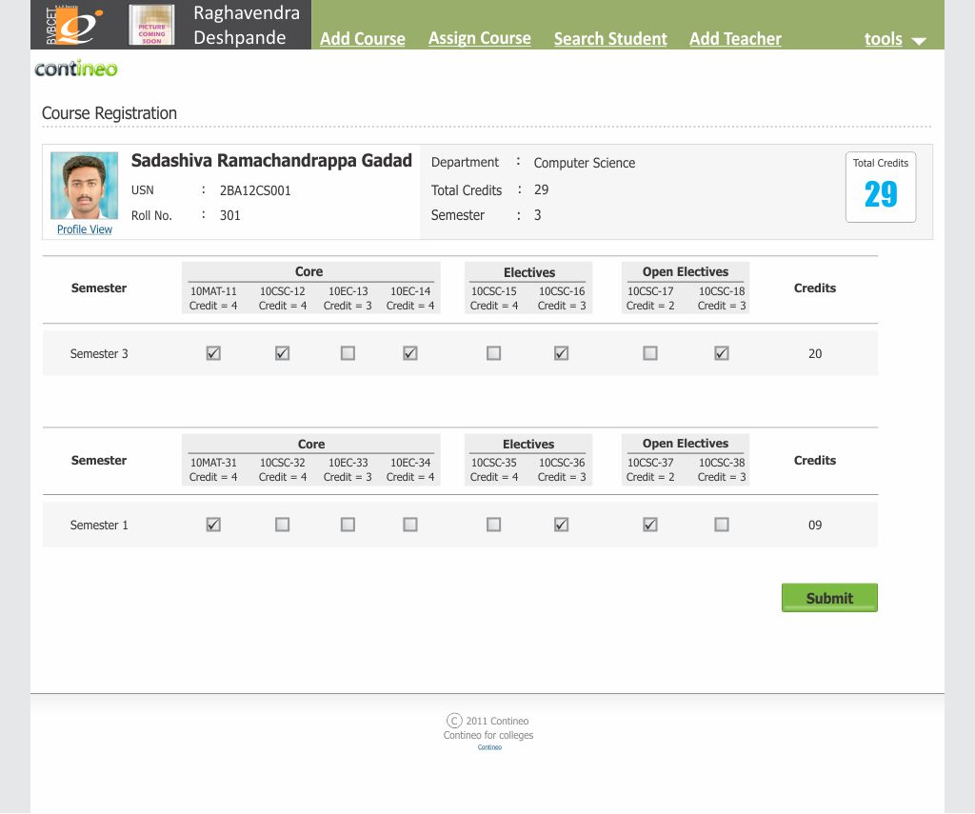
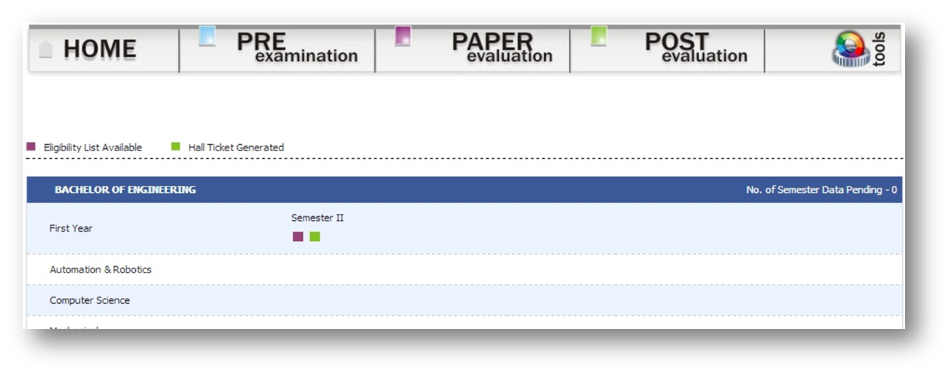
Course Registration
Examination Section
Hall-Tickets
Back

Slide 5
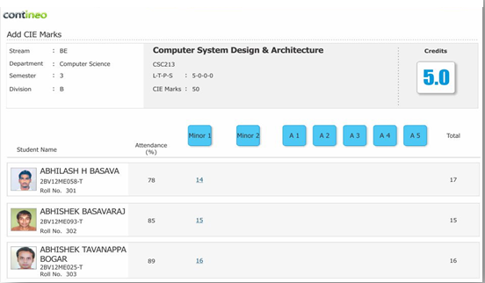
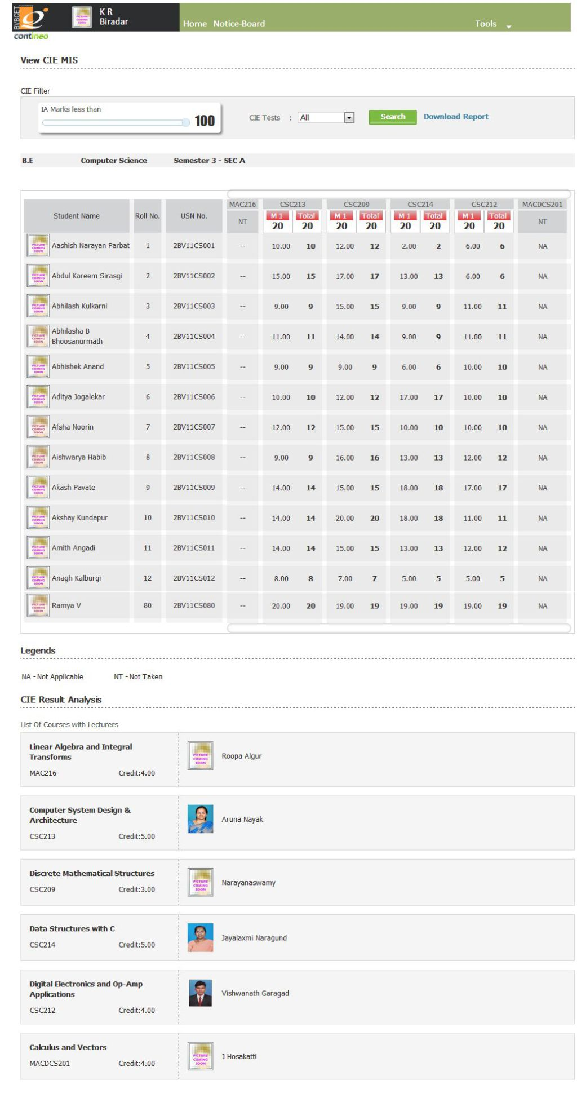
ISA Evaluation
Examination Section
Back

Slide 6
QP Process
Examination Section
User creation.
Course Assignment to User
User login Page.
Selection of QP Template.

Slide 7
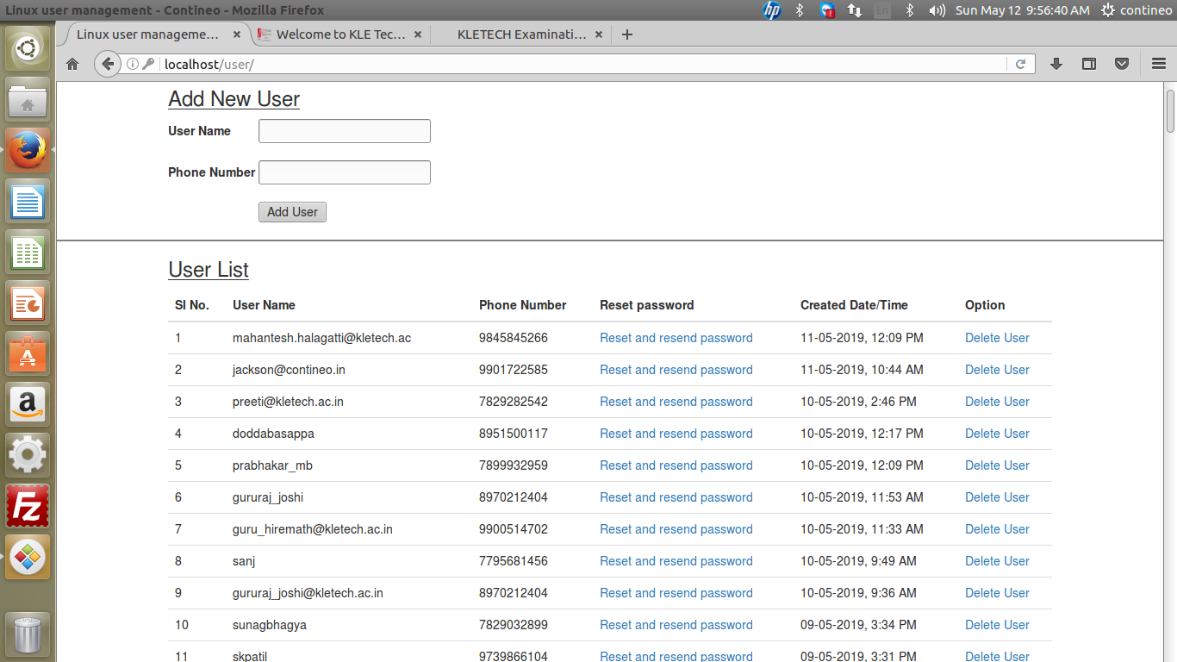
User creation
QP Process
Examination Section
Back

Slide 8
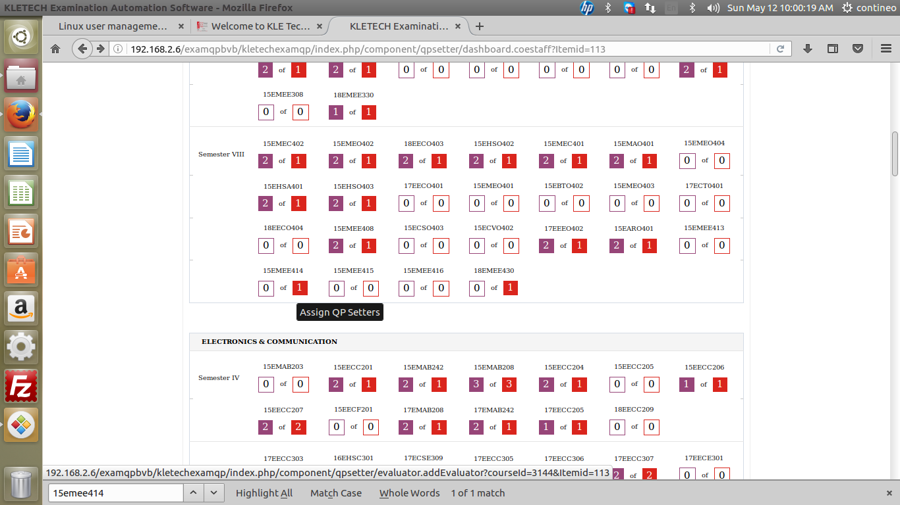
Course Assignment to User
QP Process
Examination Section
Back

Slide 9
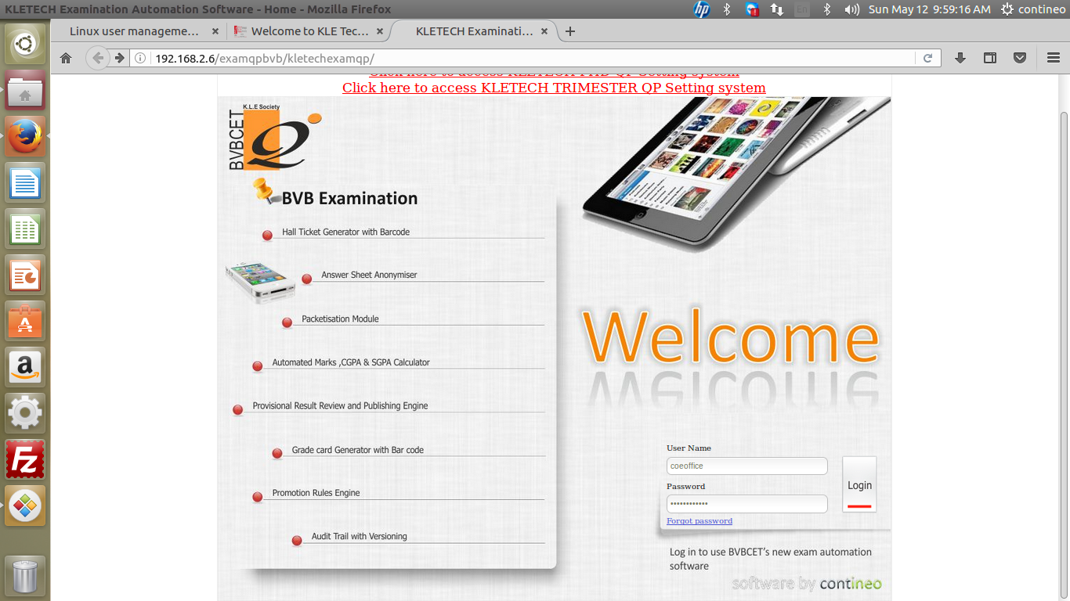
User (QP Setter) login Page
QP Process
Examination Section
Back

Slide 10
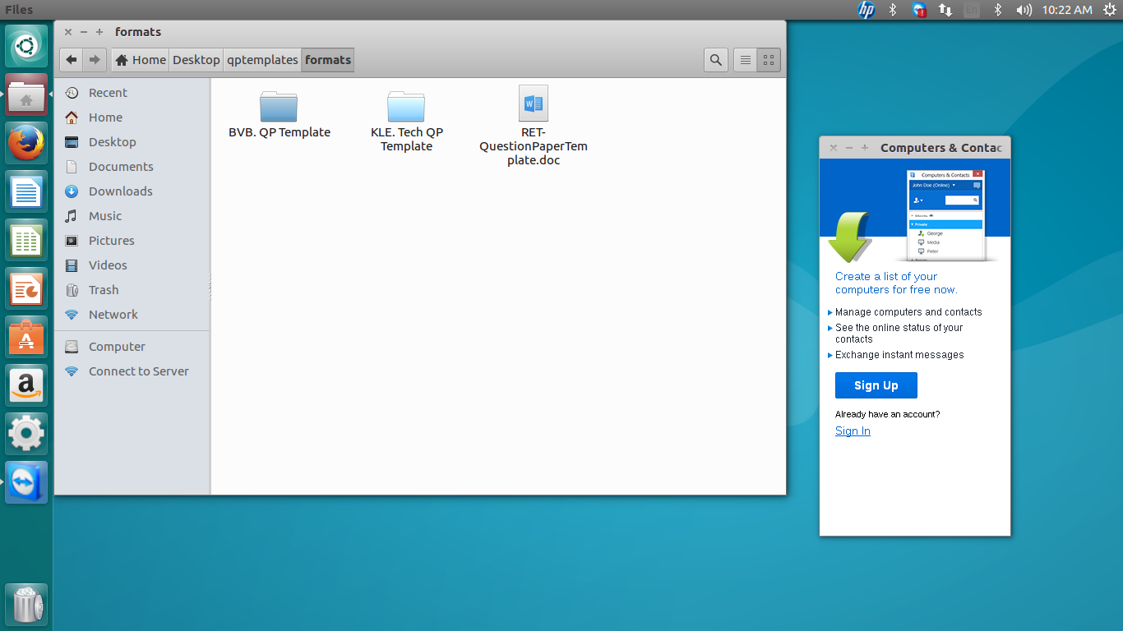
Selection of QP Template
QP Process
Examination Section
Back

Slide 11
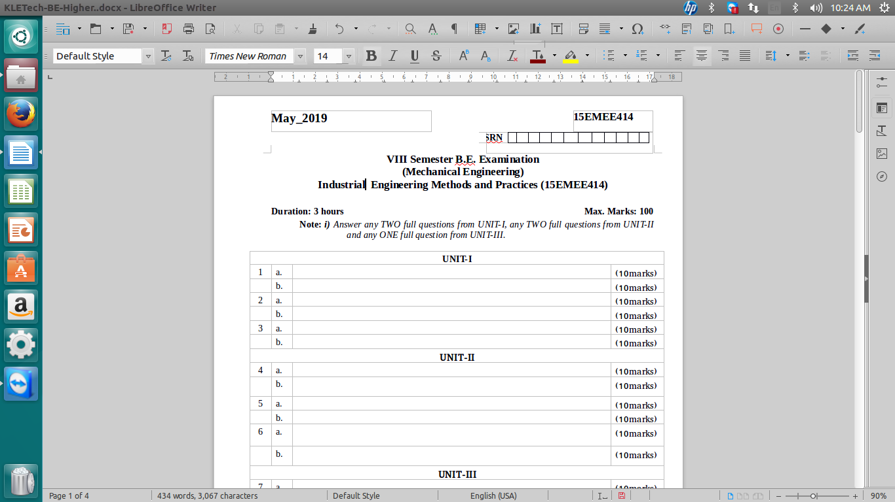
Question Paper Sample Template
QP Process
Examination Section

Slide 12
Entry of Pattern / OBE parameters and Uploading of QP into the software
QP Process
Examination Section

Slide 13
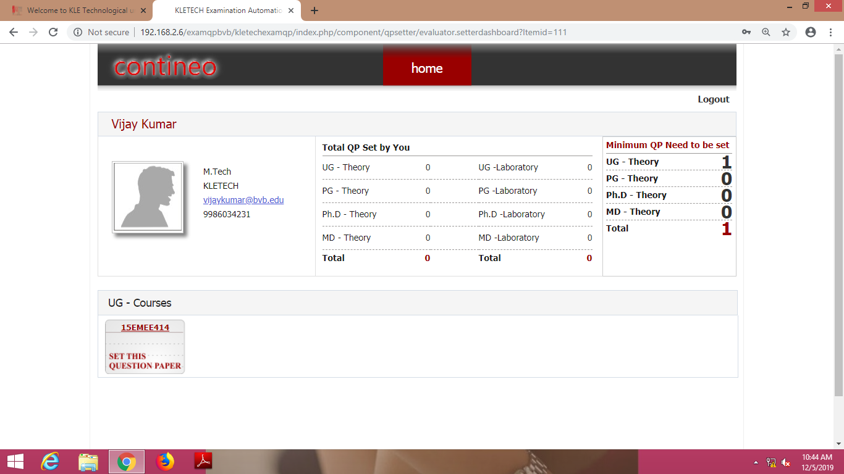
Course assigned to QP Setter
QP Process
Examination Section

Slide 14
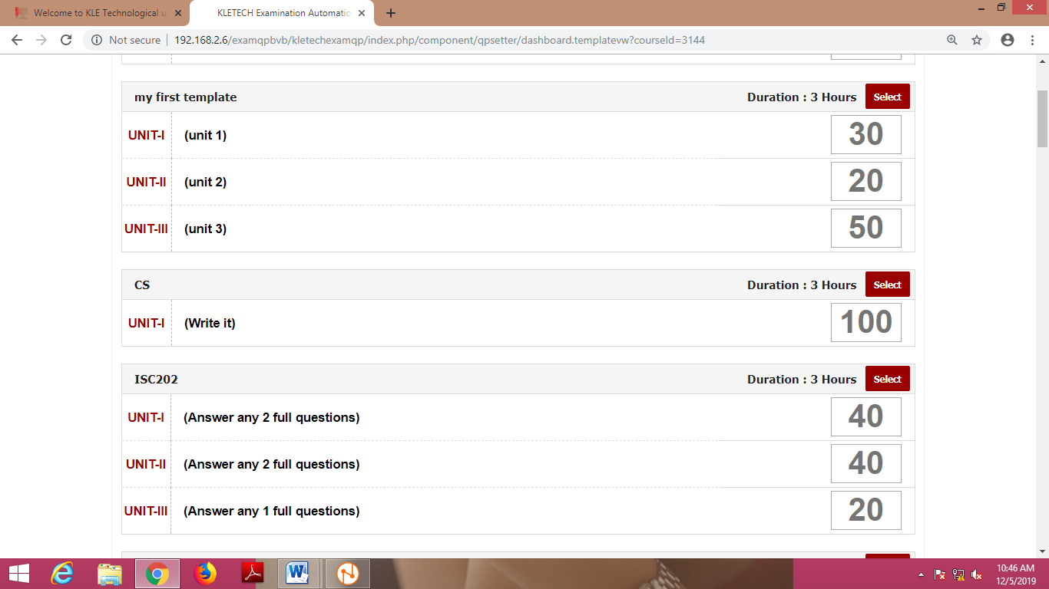
Pattern Selection
QP Process
Examination Section

Slide 15
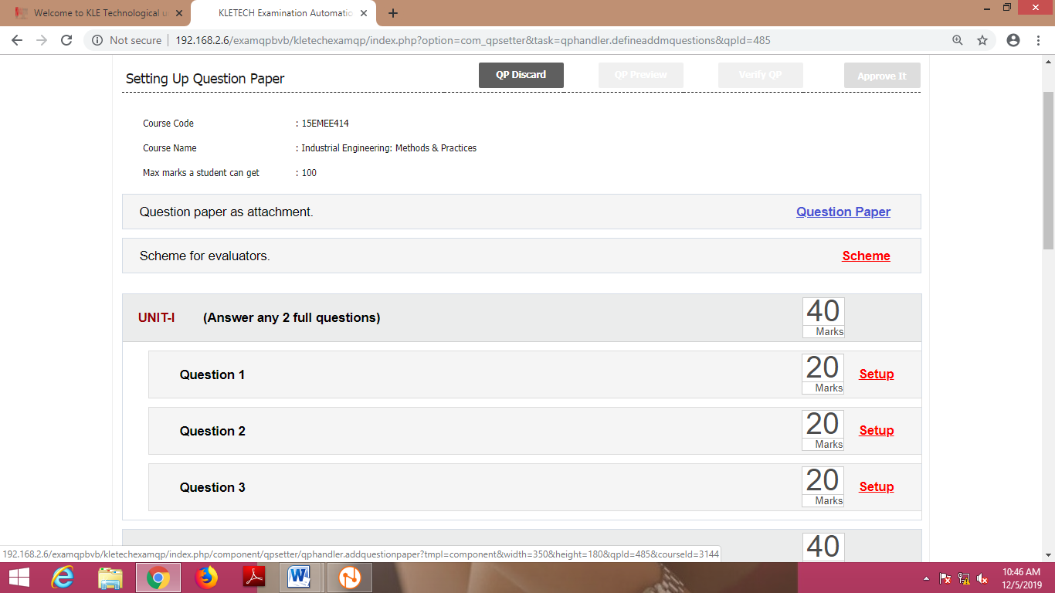
Pattern Entry
QP Process
Examination Section

Slide 16
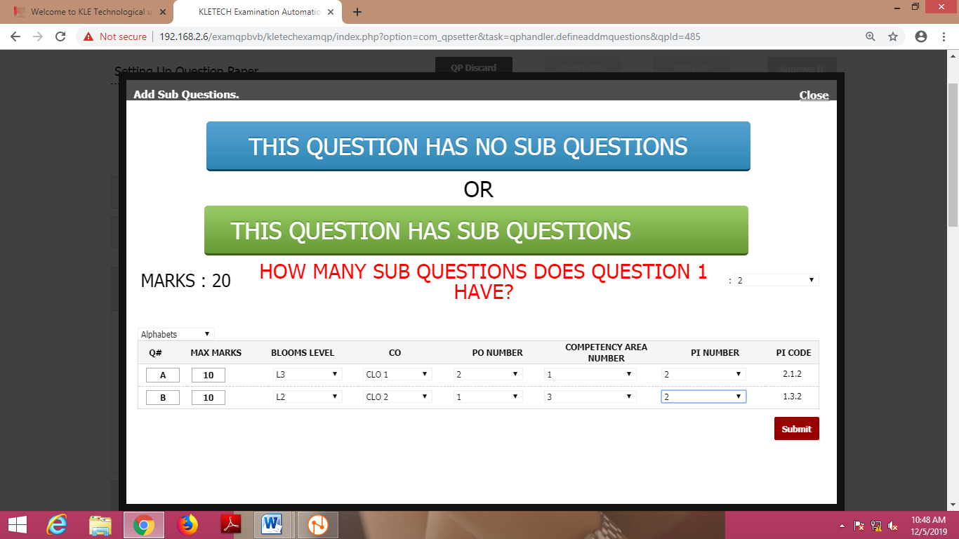
Entry of Blooms level , PO , CO, PI Code
QP Process
Examination Section

Slide 17
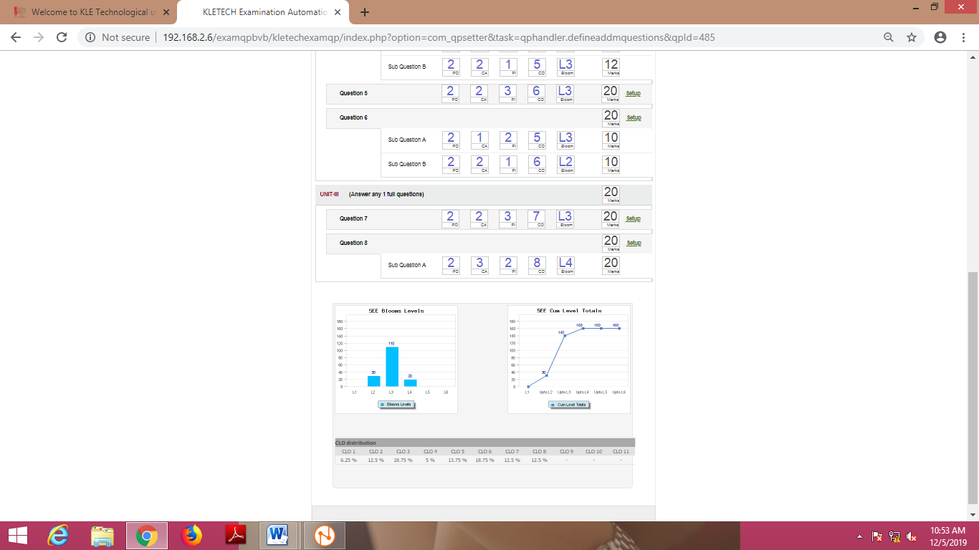
Entry of Blooms level , PO , CO, PI Code
QP Process
Examination Section

Slide 18
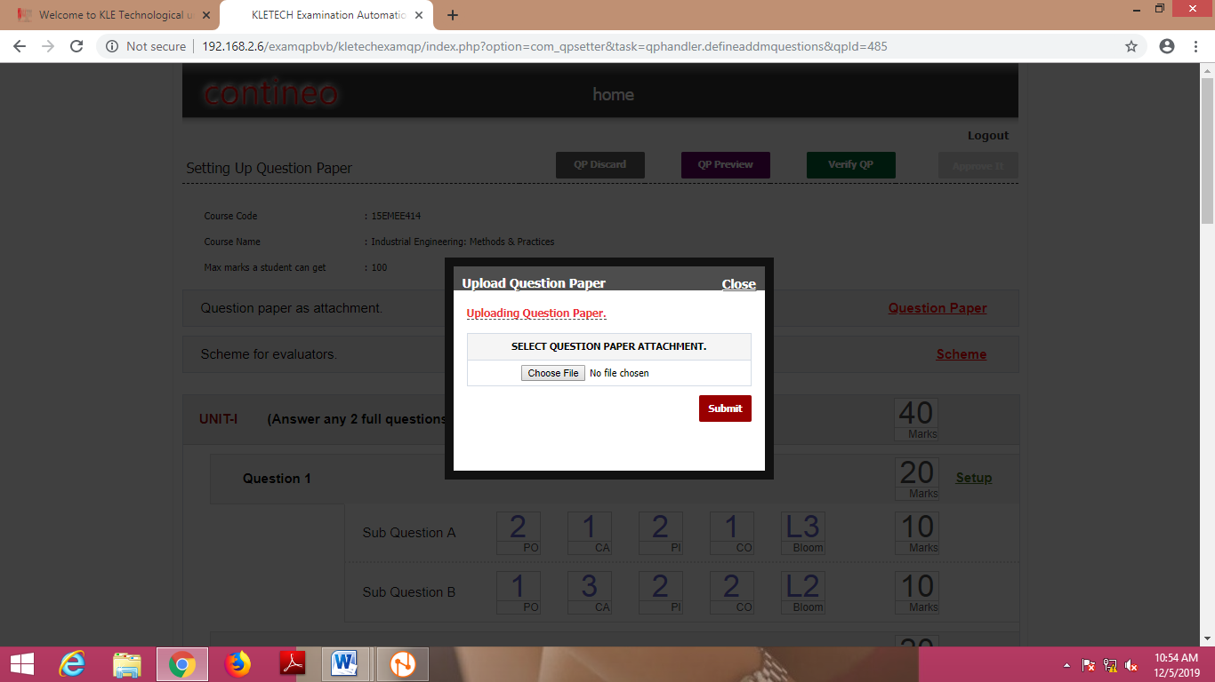
Uploading of QP and Scheme
QP Process
Examination Section

Slide 19
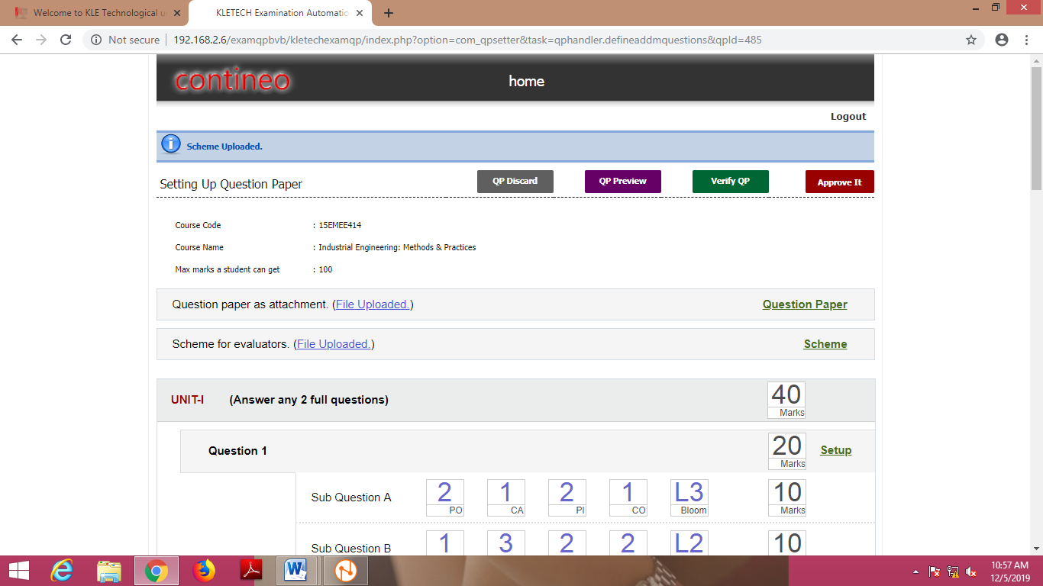
Review and Approval by QP setter
QP Process
Examination Section

Slide 20
Scrutiny
QP Process
Examination Section

Slide 21
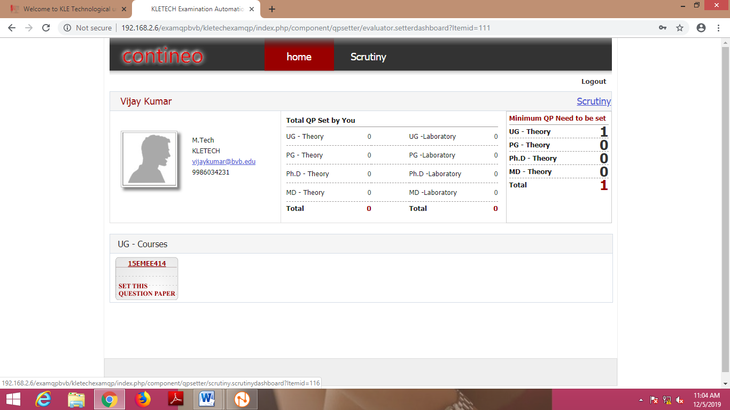
QP Process
Examination Section

Slide 22
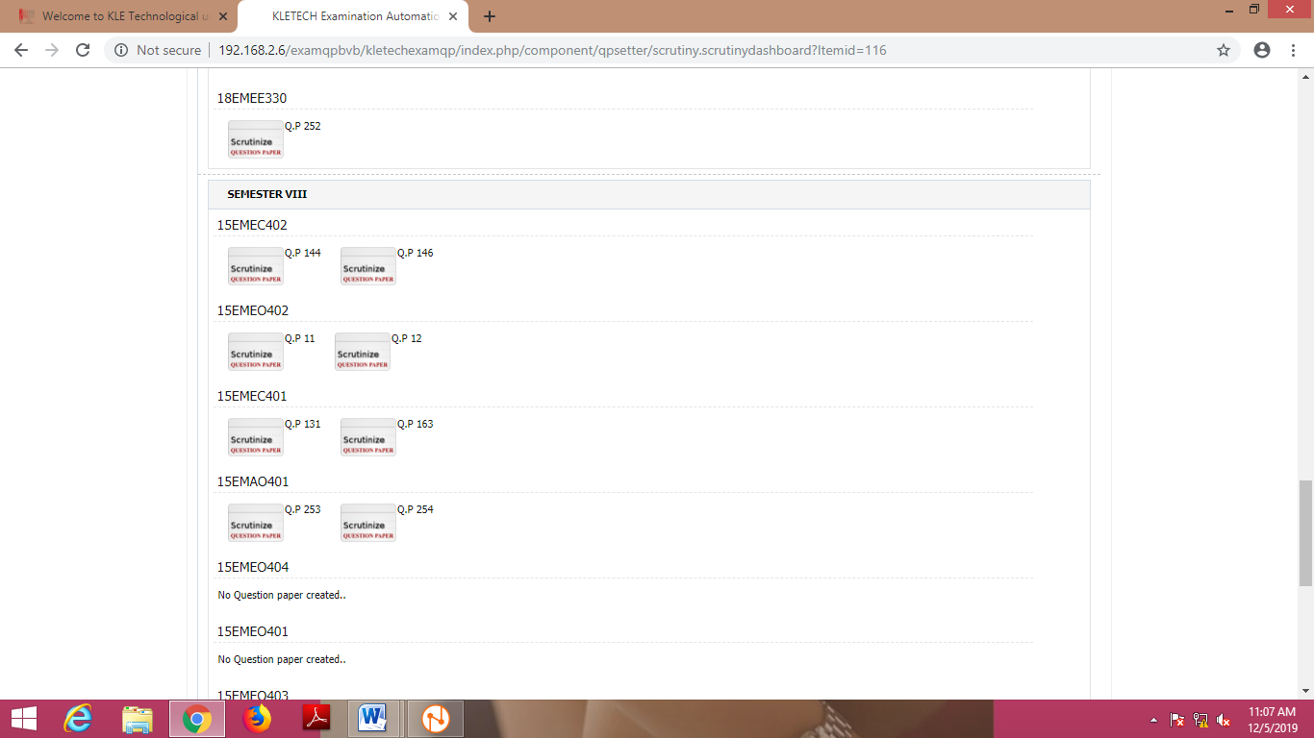
Sets to be Scrutinized
QP Process
Examination Section

Slide 23
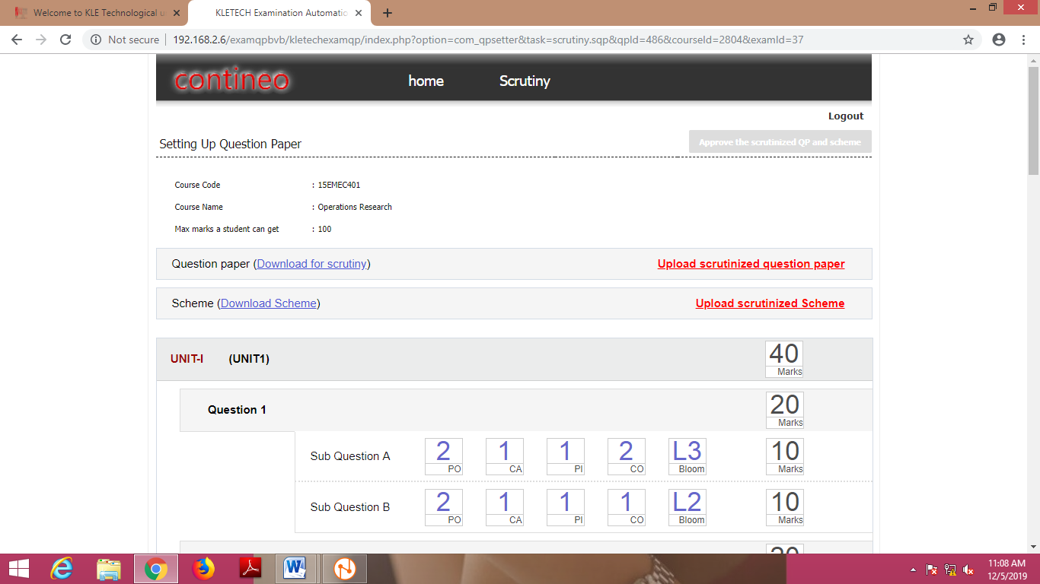
Scrutinized papers uploading
QP Process
Examination Section

Slide 24
Selection and Printing of QP
QP Process
Examination Section
Selection of QP among Multiple sets will be done TWO Hours Before the Exam by Controller of Examinations (CoE)
Selected QP will be Printed Two Hours Before the Exam based on the strength of students Registered for that Course .

Slide 25
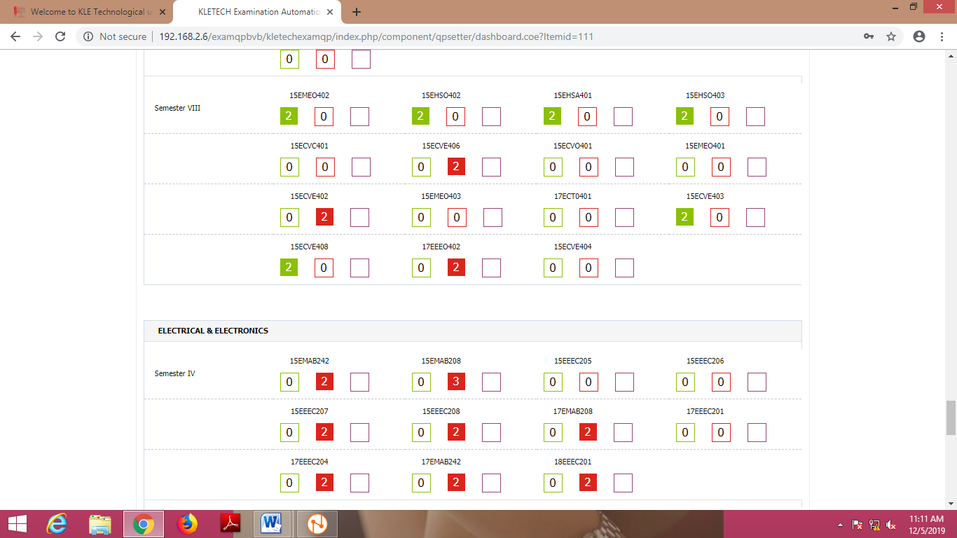
Printing Of Question Paper
QP Process
Examination Section
Uploaded but not scrutinized
Scrutinized Paper

Slide 26
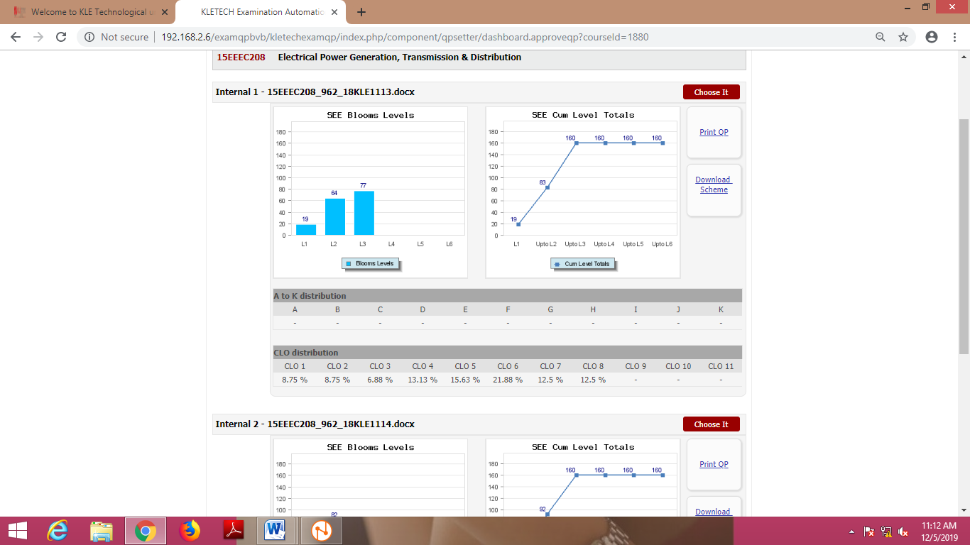
Selection of QP For Printing
QP Process
Examination Section

Slide 27
QP Process
Examination Section
Question paper quality
Once the question papers are ready, the graphs are generated to understand distribution of learning levels.
Back

Slide 28
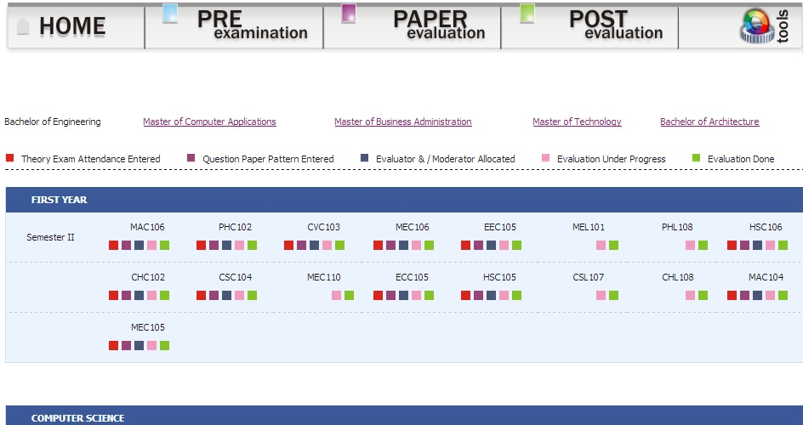
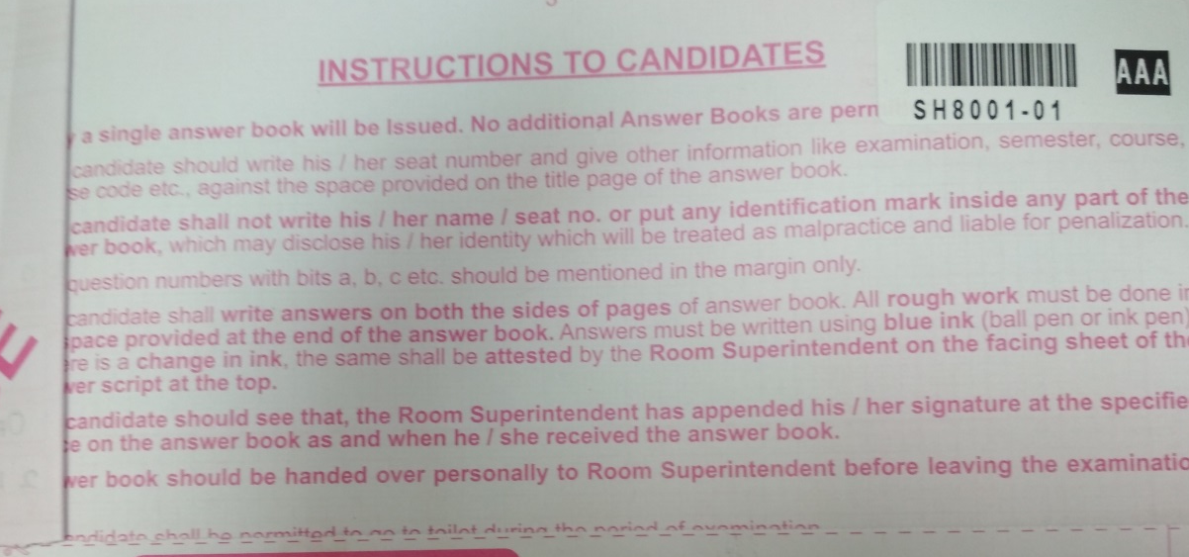
Evaluation Process
Examination Section
Answer Paper Coding

Slide 29
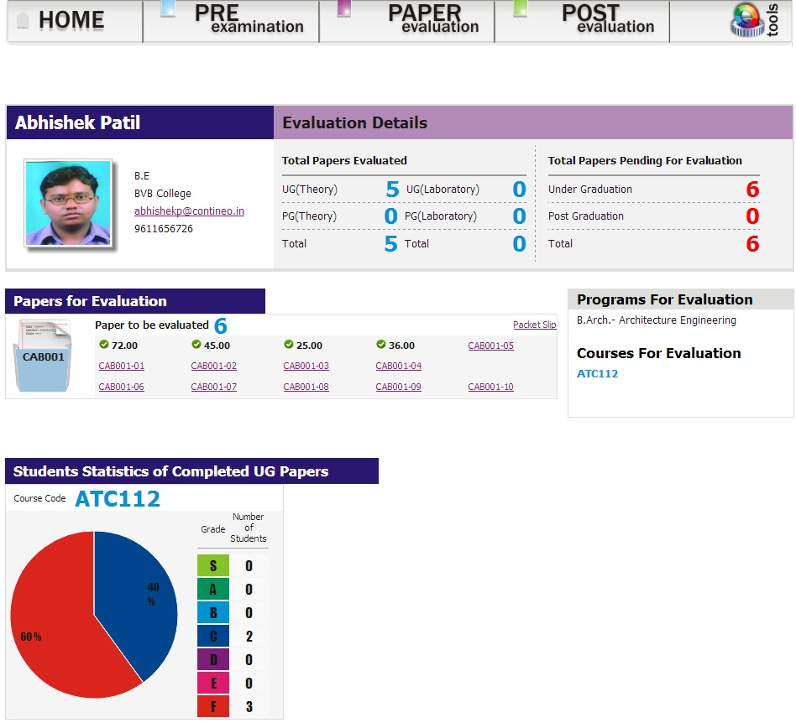
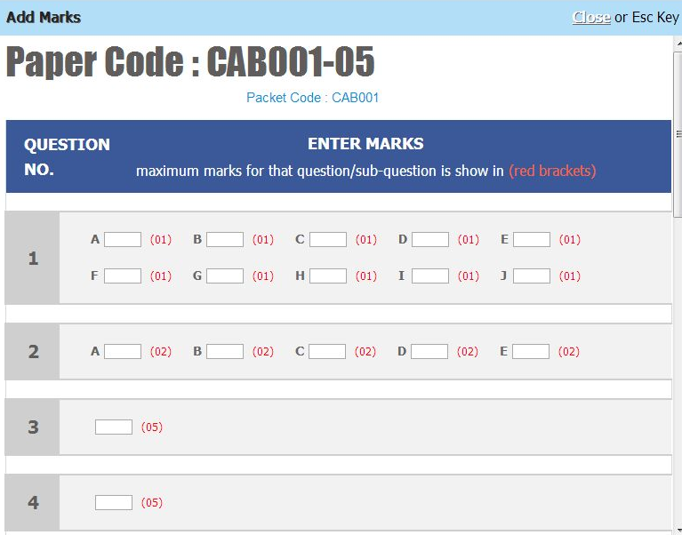
Evaluation Process
Examination Section
Evaluation – Marks Entry

Slide 30
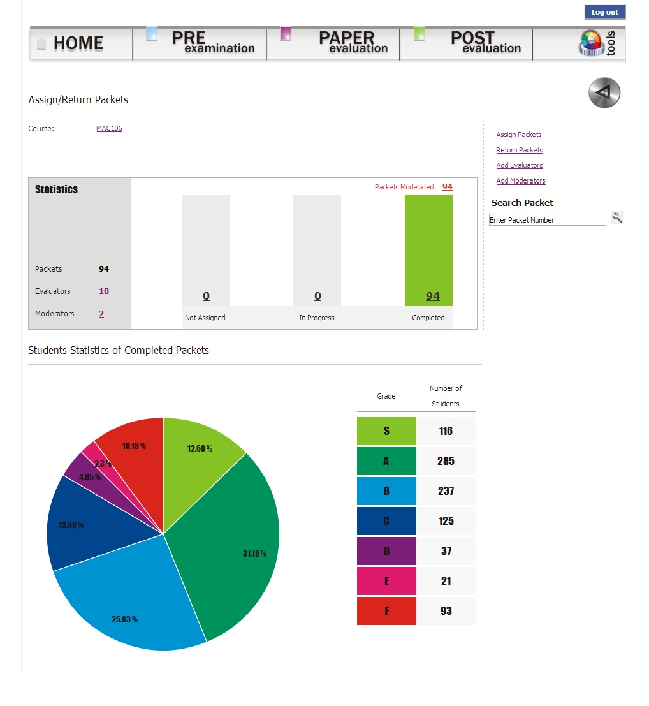
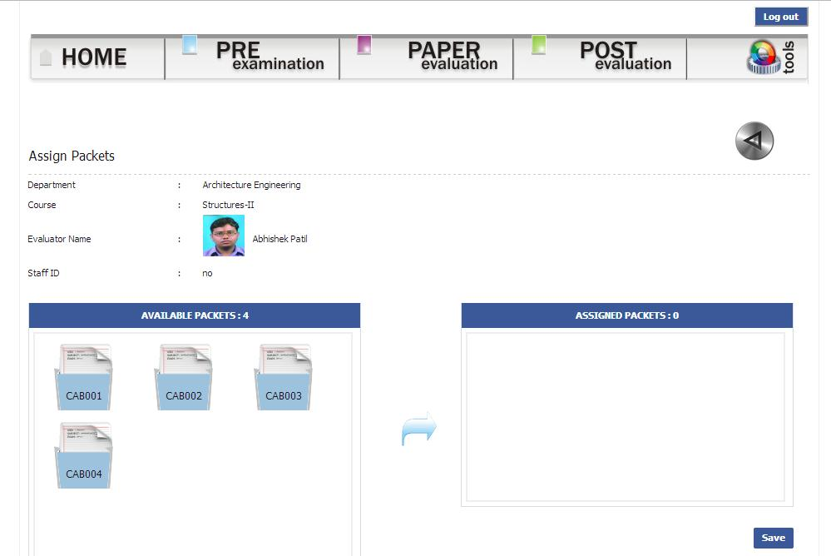
Evaluation Process
Examination Section
Evaluation – Course View
Back

Slide 31
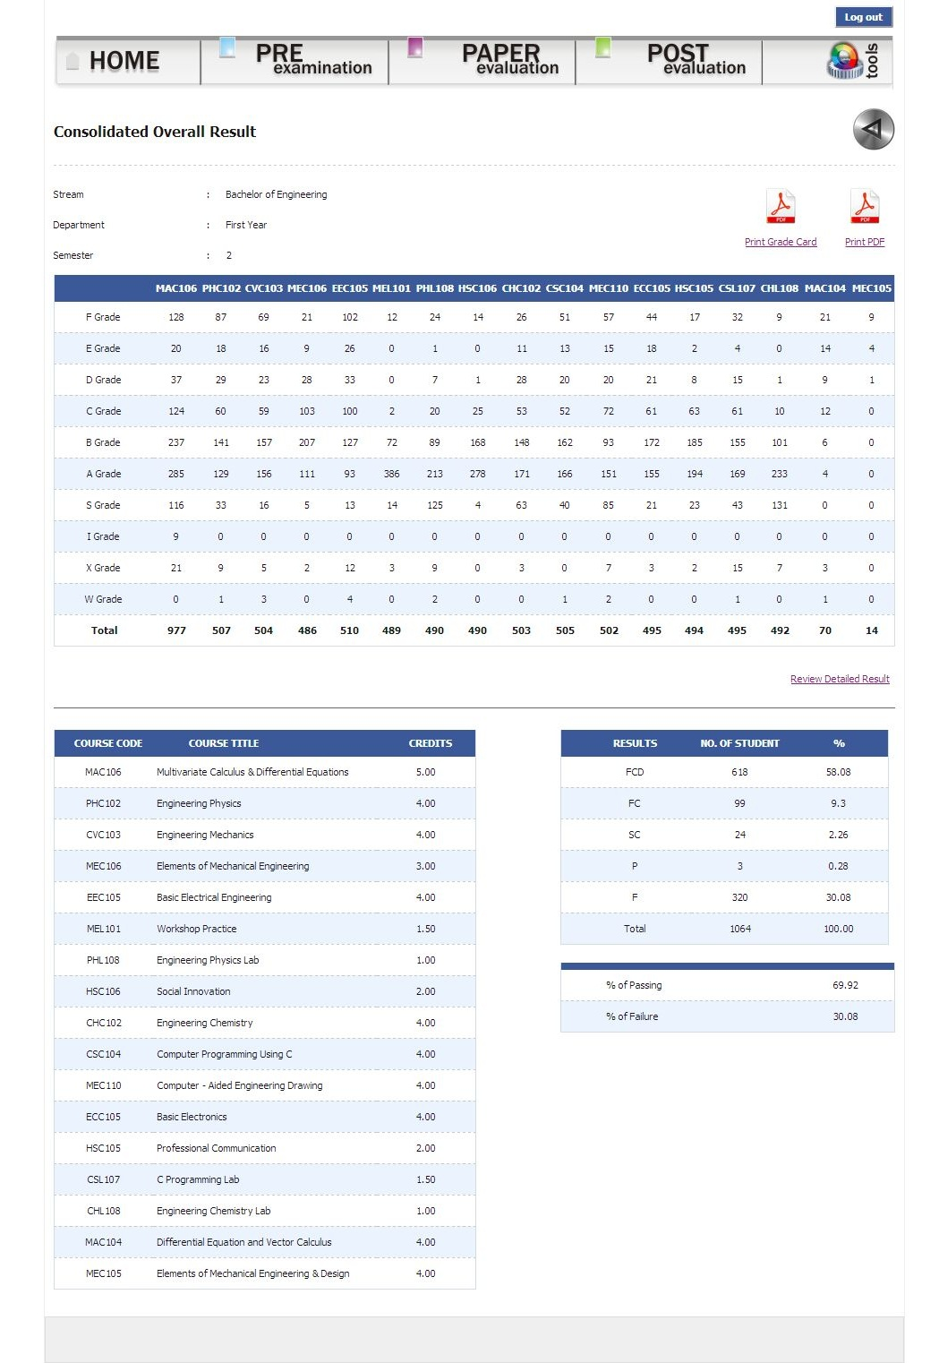

Results
Examination Section
Summary

Slide 32
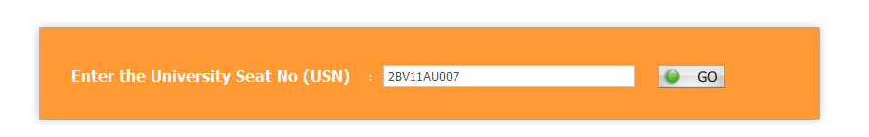
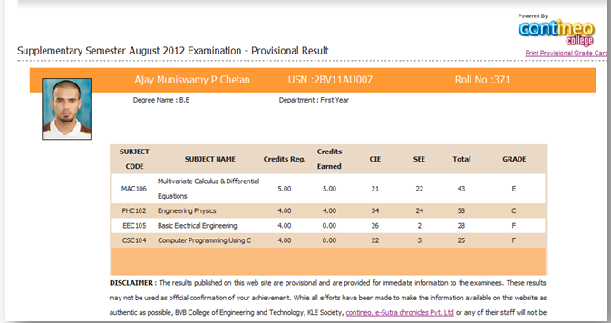
Results
Examination Section
Online Results

